Slide 1
User Guidance SRP data collection tools
February 2015

Slide 2
Content
Background on tools
Here we provide a bit more background on the purpose of the data collection tools and why, when and how to use these.
SSDCT user guidance
This section explains how to use the SRP Standard Data Collection Tool (SSDCT)
DAT user guidance
This section explains how to use the SRP Data Aggregation tool (DAT)
Contact information
This section provides contact information to ask questions and to download documents.

Slide 3
1. Background on tools (1)
Use of the tools
By SRP members and partners in collecting core field data as part of a multi-location field implementation activity to validate the SRP Standard and performance indicators.
Use in conjunction with the following SRP documents:
SRP Standard for Sustainable Rice Cultivation
SRP Performance Indicators
Implementation Protocol
Partner Declaration
All documents are available for download at the members' area of the SRP website.

Slide 4
1. Background on tools (2)
How can the tools help you?
To facilitate and support discussion / interaction between the respondent and auditor/technician.
Additional guidance for interpretation of requirements and support questions that help technicians / auditors in their contact with respondents
To facilitate consistent data collection in pilot phase and to directly present basic results.
Easy to use excel files, automated calculations
Straight forward presentation of results (individual and aggregated)
To collect valuable feedback
on the content of the standard in relation to field reality → content improvement of the standard
on user friendliness of the tools → for development of a more final it solution

Slide 5
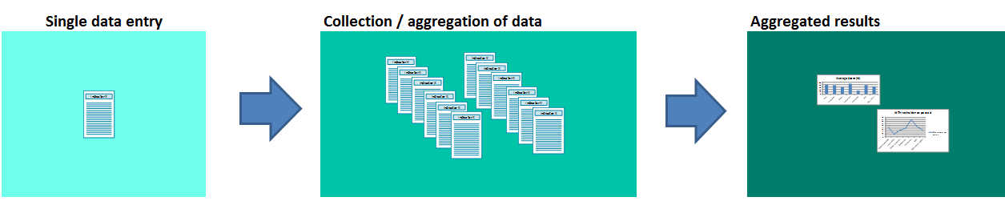
1. Background on tools (3)
Approach
The SRP standard data collection tool (SSDCT) helps to consistently gather and store information from a single farmer / site / group.
To be able to analyse data on a bigger scale, aggregation of the individual responses is required
To facilitate this in a low-tech manner, the data aggregation tool (DAT) was developed (as depicted in figure 1 below)
Figure 1: flow in data collection

Slide 6
1. Background on tools (4)
The Data collection tools have been developed as part of the pilot phase with the purpose to consistently collect and document field results. Besides field data, the SRP also collects feedback from pilots:
On content of the requirements: Are they clear, are they relevant?
On the thresholds: Are the thresholds easily met? If not, why not?
On general user feasibility of the tool: Does it work? Is it easy to use? Is it supportive in communication with farmers?
On aggregation: What type of information would be useful at aggregated level? What would help to interpret the results?

Slide 7
2. SSDCT user guidance (1)
SSDCT includes:
SRP standard
The SRP Standard has been integrated in the data collection tool to allow easy and consistent answering
Water and soil risk assessment
This provides guidance for Standard Requirement 4 and 10
Indicator dashboard
The indicator dashboard provides an overview of the collected indicator data
Indicator scorecards
The indicator scorecards allow you to automatically calculate the indicator scores, and are presented as an easy-to-use answering form.
Basic results
Finally the basic results of the performance of the standards are presented.

Slide 8
2. SSDCT user guidance (2)
Rules of thumb
Fill in all the requirements in the standard
If you have any additional remarks, suggestions or explanation, use the comments boxes to share these.
Strictly follow the instructions as mentioned in this user guidance and in the tool itself.

Slide 9
2. SSDCT user guidance (3)
Step by step guidance
The standard itself
Fill in all blue colored boxes: BLUE
Make sure you provide answers to all general questions (G1-G11b)
Make sure that you fill in all the questions related to filters (explained next slide)

Slide 10
2. SSDCT user guidance (4)
Step by step guidance
The standard itself
Filters: Not all requirements are relevant for everybody. To be able to exclude requirements that are not relevant, some filters have been added. There are 6 Filters:
Irrigation: whether you do or do not irrigate
Drying: whether you do or do not dry your rice on your farm
Storage: whether you do or do not dry your rice on your farm
Child activities: whether there are any children below 18 working on the farm
Children living on the farm: whether there are living any children on the farm
Workers: Whether you have hired workers to work on your farm
Depending on the farm context, filters may be automatically applied and requirements are removed from the list.
Note: If filters are applied, the requirements are blackned out and you should continue below.

Slide 11
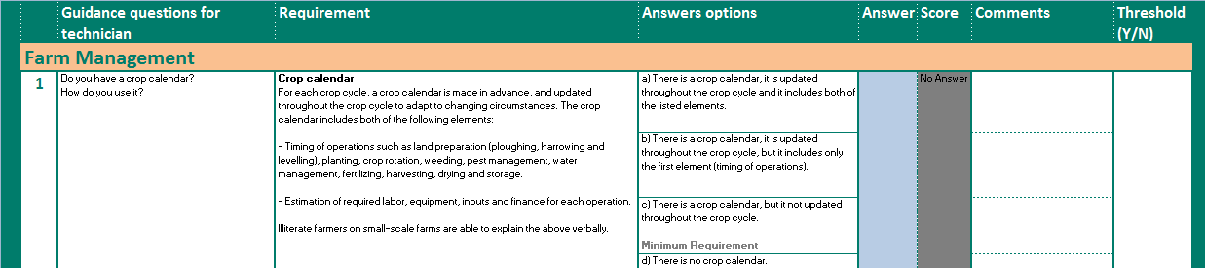
2. SSDCT user guidance (5)
Step by step guidance
The standard itself
Fill in your answer here
Guidance for auditor / technician – to help gather all relevant information to answer the requirement
The SRP requirement:
This is the requirement as presented in the Standard
The answers
Chose the most appropriate answer
You can provide additional comments here
This shows if you have met the thres-hold score
Your performance score is presented here

Slide 12
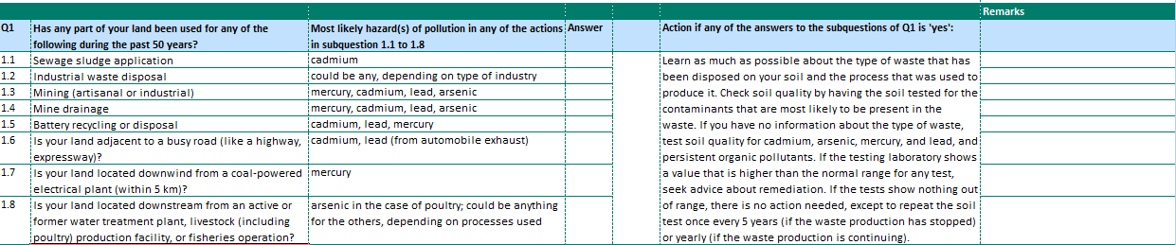
2. SSDCT user guidance (6)
Step by step guidance
Guidance to R4 and R10
Questions
There single questions, e.g. Q3-Q6 and questions with sub-questions. Please answer all applicable questions
Most likely hazared for pollution
This helps you to consider what could be the pollution hazard.
The answers
Simple yes/no answers
Action if any of the questions is answered with ‘yes’ for e.g. Q1
If there is any type of pollution identified, action is needed. This column provides guidance on what action may be relevant.
You can provide additional remarks here

Slide 13
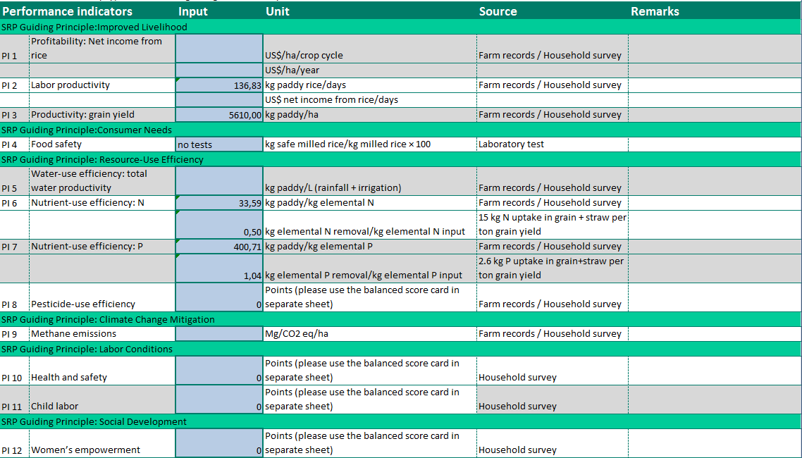
2. SSDCT user guidance (7)
Step by step guidance
Impact Indicator Dashboard
Use this to collect data about the impact indicators
Fill in all the anwers and the score is calculated automatically
If relevant you can leave remarks in column H
For 4 impact indicators (IP8, IP10,IP11 and IP12) scorecards have been developed to determine a score for the indicator. These are presented in separate sheets
Fill in the blue cells. The cells for IP8, IP10,IP11 and IP12 are automatically populated when the scorecards are filled in.
Use the unit that is applicable.

Slide 14
2. SSDCT user guidance (7)
Impact Indicator Dashboard
Data needed to calculate Performance Indicators
P1 – actual sale price of rice/ha per crop cycle; total sale/ha/year
P2 – rice yield and growth duration of variety and total labor used
P3 – yield (kg)/ha
P4 – laboratory test
P5 – yield/ha, amount of water use (irrigation + rainfall)
P6 – yield, amount of elemental N fertilizer applied
- nutrient taken up/removed by the plants and elemental N applied
P7 - – yield, amount of elemental P fertilizer applied
- nutrient taken up/removed by the plants and elemental P applied
P8 – use balanced score card
P9 - water use (flooded/non-flooded condition); if flooded , crop duration in days; pre-season flooding condition/duration; straw incorporation, farmyard manure application, green manure incorporation
P10 - use balanced score card
P11 – use balanced score card
P12 – use balanced score card

Slide 15
2. SSDCT user guidance (8)
Step by step guidance
Impact indicator scorecards
Use these to determine the score for IP8, IP10,IP11 and IP12
Fill in all answers. If relevant you can leave remarks in column H
Indicator
The overall impact indicators are based on a series of individual indicators. These are presented in the score cards
Corresponding requirement
The indicators relate to requirements of the standards. This is presented here
Performance level
Indicate the performance level of the farm
Score
This is the score per answer. Total score 9max 100pts) at the bottom
Asnwer here
Points
Received points for this question
Remarks
If relevant add your remarks here

Slide 16
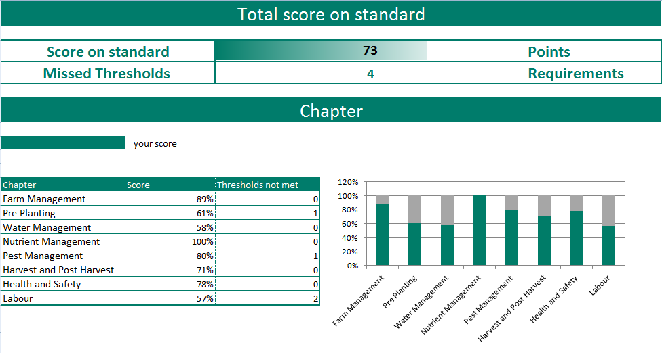
2. SSDCT user guidance (9)
Step by step guidance
Basic results presentation per chapter and impact category

Slide 17
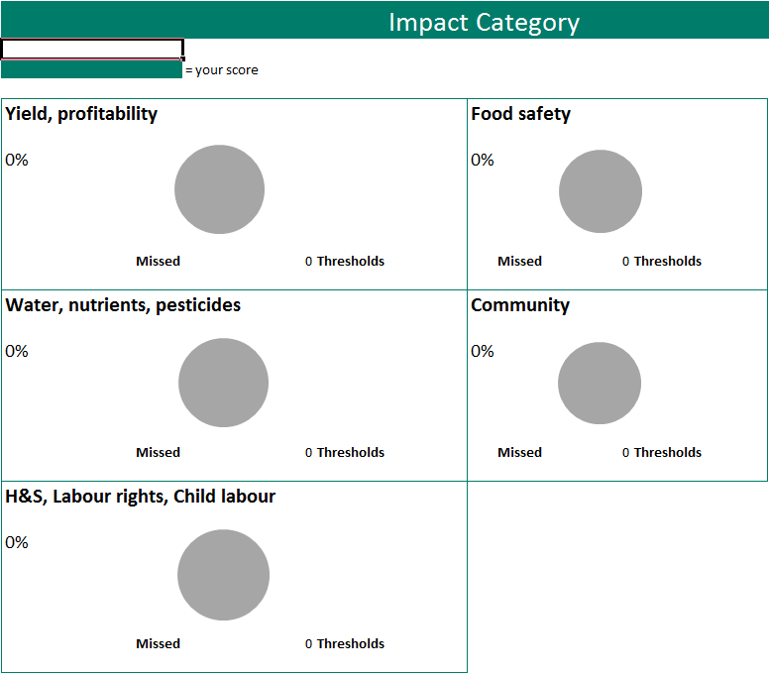
2. SSDCT user guidance (9)
Step by step guidance
Basic results presentation per chapter and impact category

Slide 18
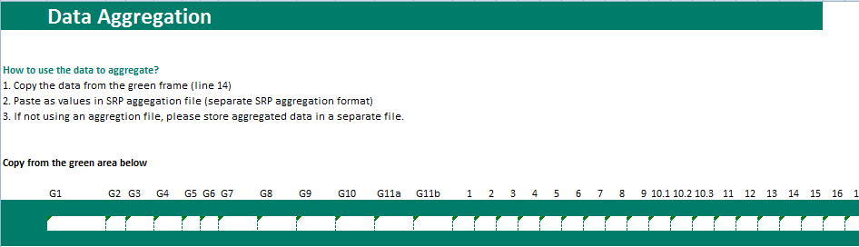
2. SSDCT user guidance (9)
Step by step guidance
To Aggregation
When data is aggregated, use this sheet to transfer data to the DAT (Data Aggregation Tool)
Copy the cells within the green area, line 14 (Select area - ctrl-C or right mouse click and select copy). The area that has to be copied is B14 to DR16 (B14:DR16). This area is automatically filled with the answers to all the questions in the SSDCT. Copy this in the DAT using the paste as values option. More instructions in DAT user guideline.

Slide 19
3. DAT user guidance (1)
Data Aggregation Tool (DAT)
Aggregation of data from individual respondents
Automated calculations
Overview of general results

Slide 20
3. DAT user guidance (2)
Rules of Thumb
Fill in all the requirements in the standard and use the aggregation sheet to copy-paste the data into the DAT
Strictly follow the instructions as mentioned in this user guidance and in the tool itself.

Slide 21
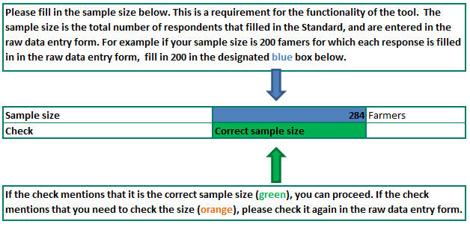
3. DAT user guidance (3)
Step by step guidance
Sample Size
Fill in the size of the sample for which you like to aggregate data in the blue box. You have to be exact. The tool requires the exact sample size for proper functioning.
When the size you entered and the number of respondents in the raw data entry from are the same, the check becomes green

Slide 22
3. DAT user guidance (4)
Step by step guidance
Raw Data Entry form
This is the core of the DAT, where the raw data from the SSDCT is entered per farmer.
Use the SSDCT ‘to aggregation’ sheet to copy the raw data from. Use ‘past as values’ option as mentioned in the instructions at the top of in the Raw Data Entry form.
Each line is an individual respondent
If not using the SSDCT, you can manually fill in the data for each respondent. However we would like to stress to use the SSDCT. Note that you should still use the standard as presented in the standard data collection tool (SDCT), as this is the order of questions used for aggregation (the paper/pdf document diverts from this). If manually filling in, please be very strict and consistent as the DAT may not function properly due to occurring errors.

Slide 23
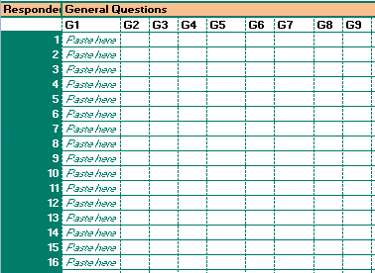
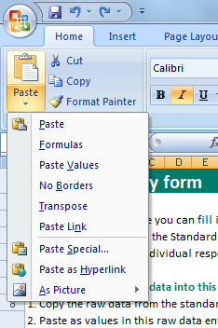
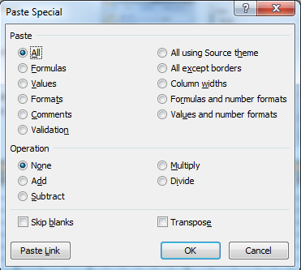
3. DAT user guidance (4)
Step by step guidance
Raw Data Entry form
‘Paste as values’ instructions
i) Select cell in column B, right mouse click, 'paste special', 'values'.
Ii) Select cell in column B. In 'home'-tab, Clipboard menu, use ' paste' button, Paste special, 'values' see pictures on the right
Paste in this cell the data from the 1st respondent, using the past as value option

Slide 24
3. DAT user guidance (5)
Step by step guidance
Calculations
In this part of the DAT all calculations take place. This is not accessible to the users

Slide 25
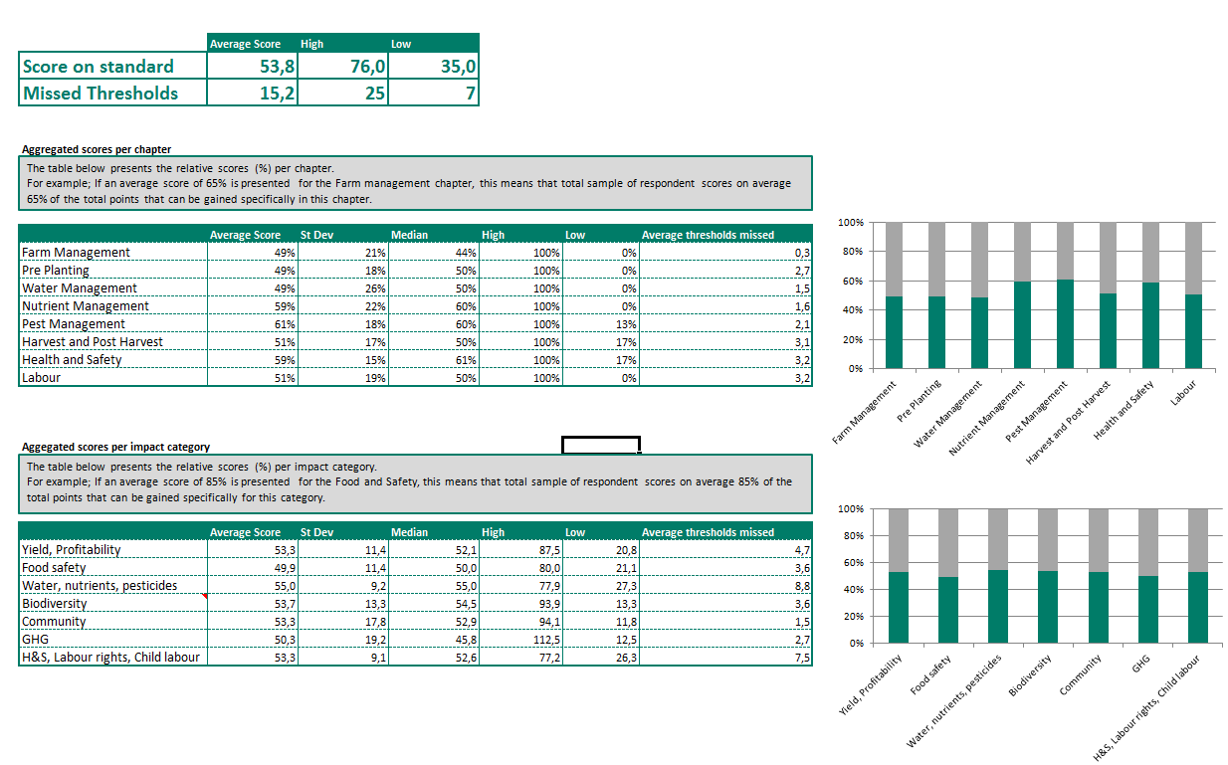
3. DAT user guidance (6)
Data Aggregation Tool (DAT)
Overview of general results

Slide 26
4.Contact details
The data collection tool can be downloaded from the Members’ Area of the SRP website:
www.sustainablerice.org
For any other questions please contact the SRP Secretariat:
Secretariat@sustainablerice.org

